Slide 1


Team Name : INSIGHT MINERS
Team Leader Name : Pritik Kumar Mohanty
Problem Statement : AI-Powered Solar Panel Dust Detection & Automated Cleaning System

Slide 2

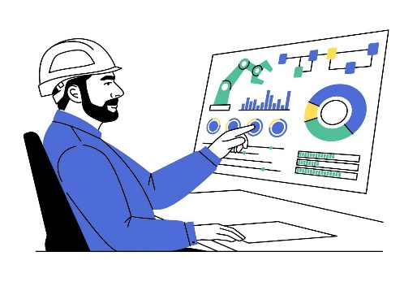
Team Leader: Name: Pritik Kumar Mohanty College: N.K.Orchid College Of Engg and Technology Solapur LinkedIn: www.linkedin.com/in/pritikkumar
Team Member 1: Name: Nitish Channapattan College: N.K.Orchid College Of Engg and Technology LinkedIn: www.linkedin.com/in/nitish-channapattan-683984299 | Team Member 3: Name: Mayur Rupnar College: N.K.Orchid College Of Engg and Technology LinkedIn: https://www.linkedin.com/in/mayur-rupnar-7a339b28a/
Team Member 2: Name: Onkar Jamma College: N.K.Orchid College Of Engg and Technology LinkedIn: https://www.linkedin.com/in/onkar-jamma-616010258/ | Team Member 4: Name: Sangram Dalave College: N.K.Orchid College Of Engg and Technology LinkedIn: https://www.linkedin.com/in/sangram-dalave-840a58245/
Team Members

Slide 3
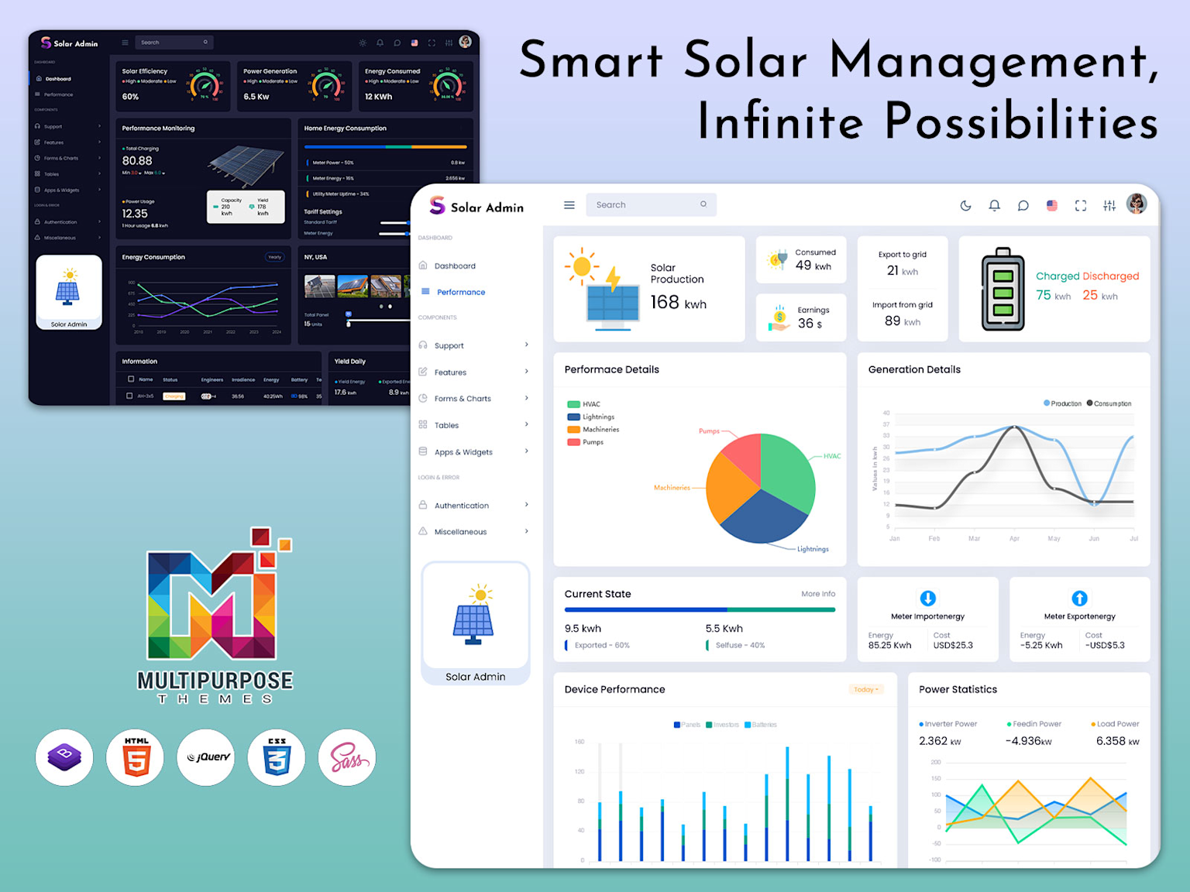
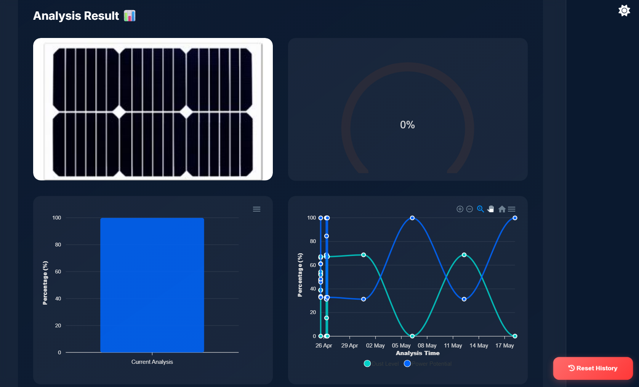
Brief about the Idea:
SOLARENSE is an AI-powered autonomous system that revolutionizes solar panel maintenance through intelligent dust detection and automated cleaning.
The Big Problem: India loses ₹15,000 crores annually due to dust-reduced solar efficiency (20-30% power loss). With 75 GW installed capacity growing to 500 GW by 2030, this problem will cost ₹1 lakh crore in lost energy.
Our Solution: Patent-pending VGG16-SVM hybrid AI algorithm detects dust in real-time, triggers water-efficient automated cleaning, and provides predictive maintenance - all at 70% lower cost than existing robotic solutions.
Market Impact: Targeting ₹1,260 crore solar cleaning market with our ₹25,000-50,000 system vs ₹50+ lakh competitors.

Slide 4
OUR SOLUTION
AI-Powered Dust Detection
Hybrid VGG16–SVM model identifies dust in real-time with ~73–75% accuracy.
Automated Cleaning System
Robot cleaners triggered instantly by AI → timely, efficient, and water-saving.
Sustainable & Affordable
Uses little/no water, reduces O&M costs by 40%, boosts energy output by 25–30%.
Patented AI detection
Ensures a unique and
high-accuracy cleaning system not offered by others
IoT + Edge Integration
Continuous monitoring, predictive maintenance, and <30ms response time.

Slide 5
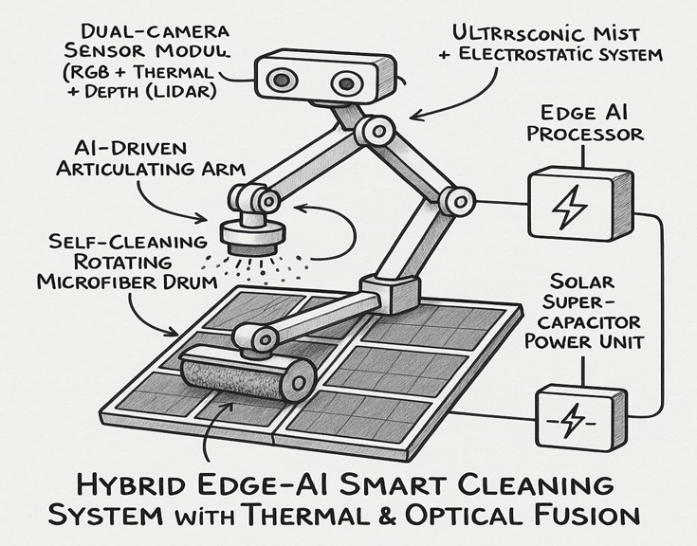
List of features offered by the solution
CORE FEATURES:
AI Dust Detection Engine: Real-time computer vision analysis
Automated Cleaning System: Motorized brush + ultrasonic mist spray
Predictive Maintenance: Weather-based cleaning schedule optimization
IoT Dashboard: Remote monitoring and control via mobile/web app
Water Conservation Mode: 90% reduction in water usage
Emergency Response: Instant cleaning during dust storms
Performance Analytics: ROI tracking and efficiency reports
Modular Design: Expandable for different solar installation sizes
Edge Computing: Local processing for <30-second response time

Slide 6


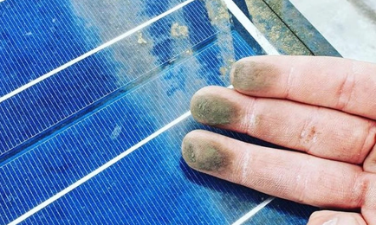










Methodology ???
Dust Detection
Automated Cleaning
Image Captured with Camera
AI Processing and Analysis
Monitoring and Prediction

Slide 7
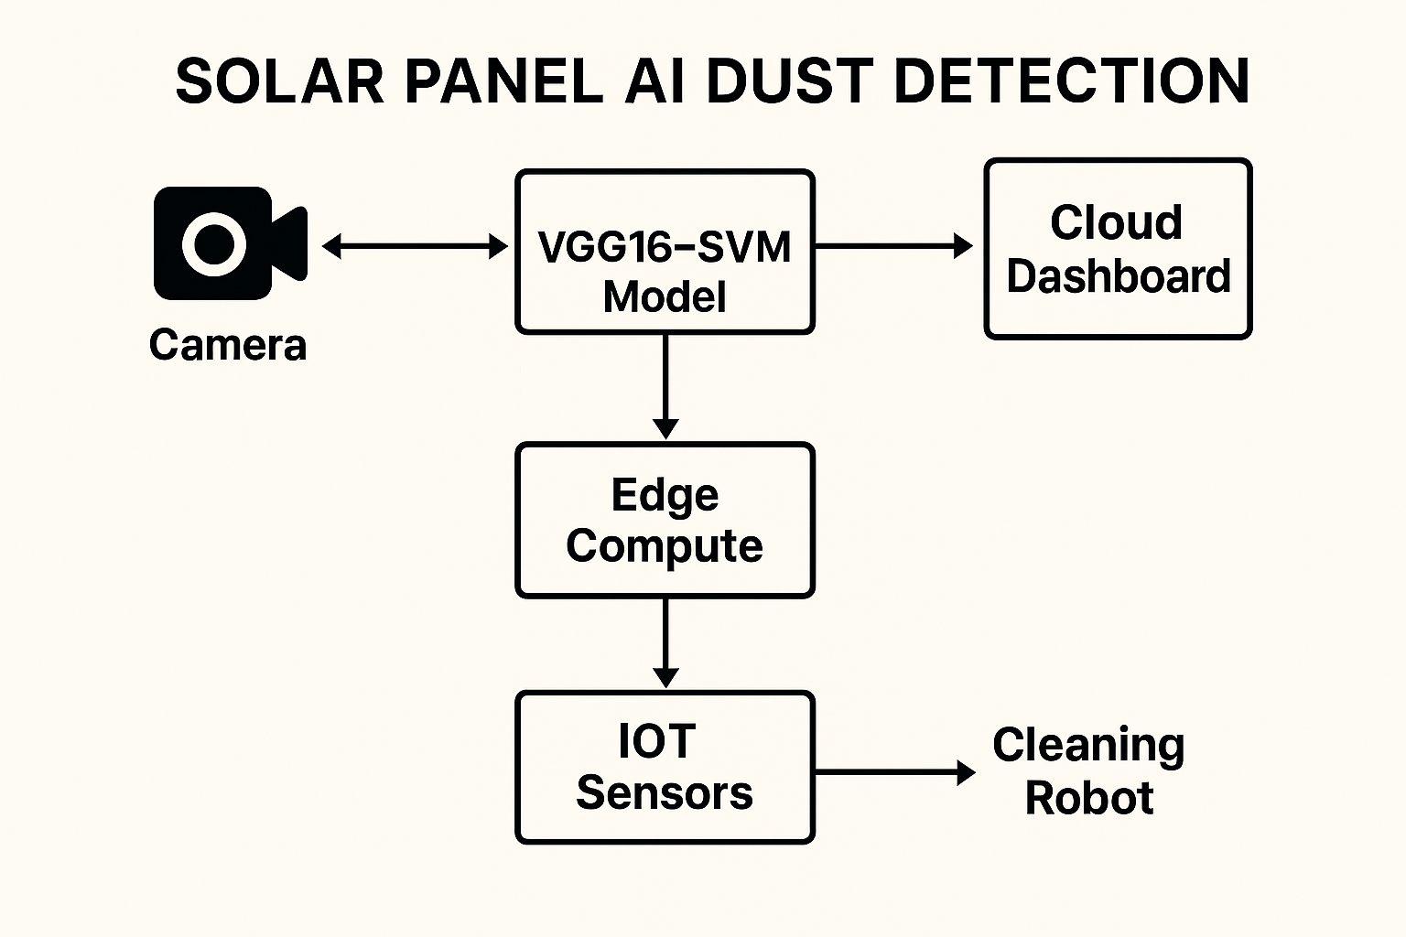
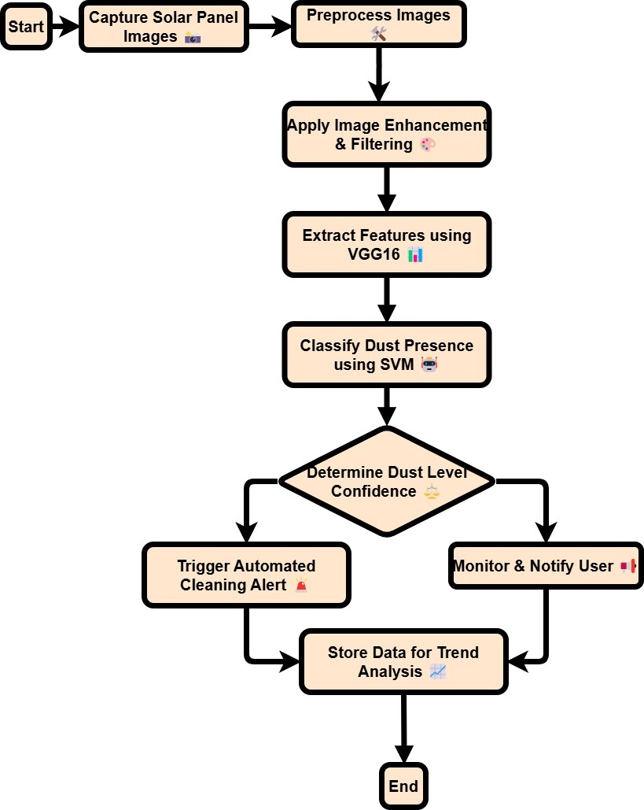
Process flow diagram or Use-case diagram

Slide 8


MOCK DIAGRAM
01
02
03
04
05
IMAGE CAPTURE WITH CAMERA
Monitoring and Prediction
DUST DETECTION
AI Processing & Analysis
Automated Cleaning
Cameras/IoT sensors capture real-time images of solar panels.
Hybrid VGG16–SVM model identifies dust by feature extraction
SVM model identifies dust with high accuracy.
AI triggers robotic cleaning unit using minimal/no water.
IoT dashboard tracks performance, efficiency gain, and schedules predictive maintenance.

Slide 9
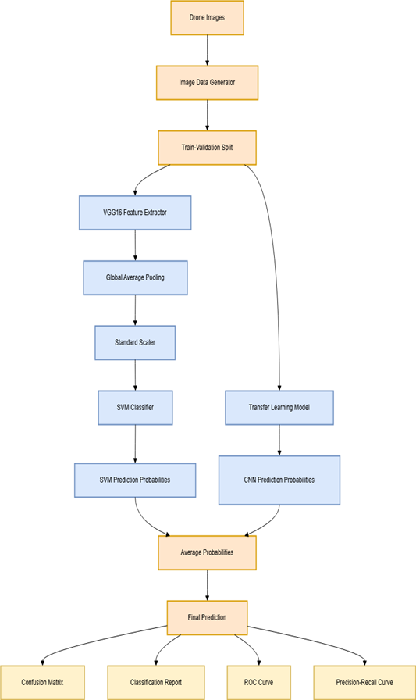
Architecture diagram of the proposed solution:
This architecture diagram illustrates the process of a system to detect dust on a solar panel with drone imagery and machine learning. It outlines the process from drone images, train-validation with train-validation splits in order to get the data ready for training models. The training data is then passed through a VGG16 feature extractor to get meaningful features from the training data, global average pooling, and standardization by using a Standard Scaler. These features are input into an SVM classifier to produce SVM prediction probabilities.

Slide 10







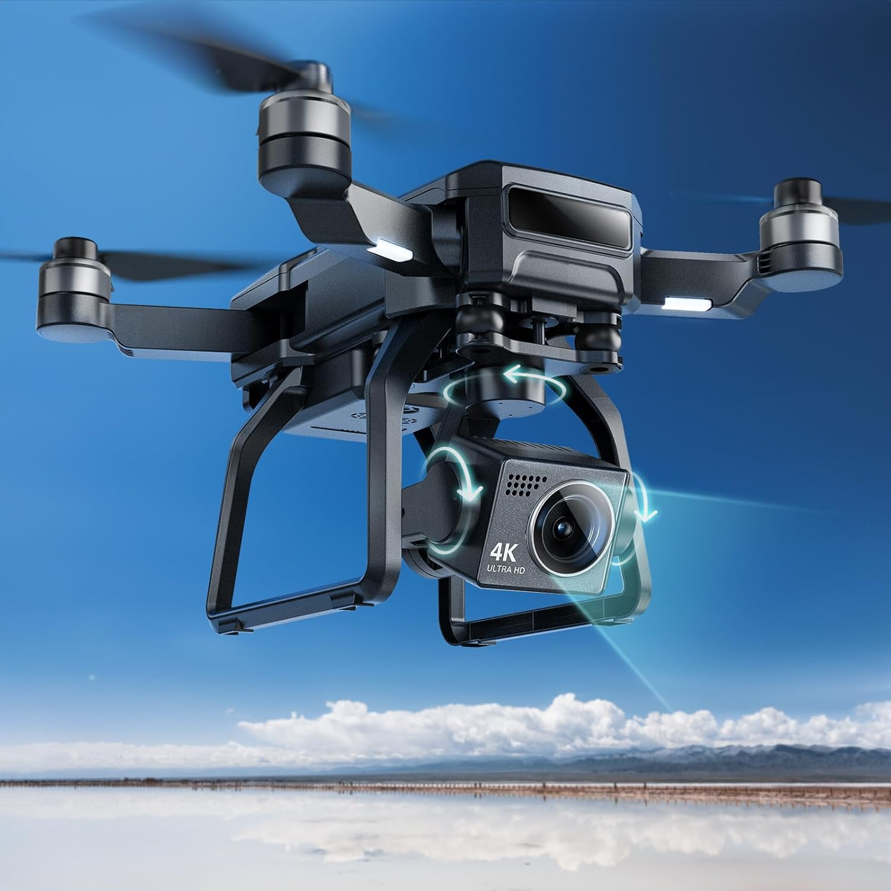
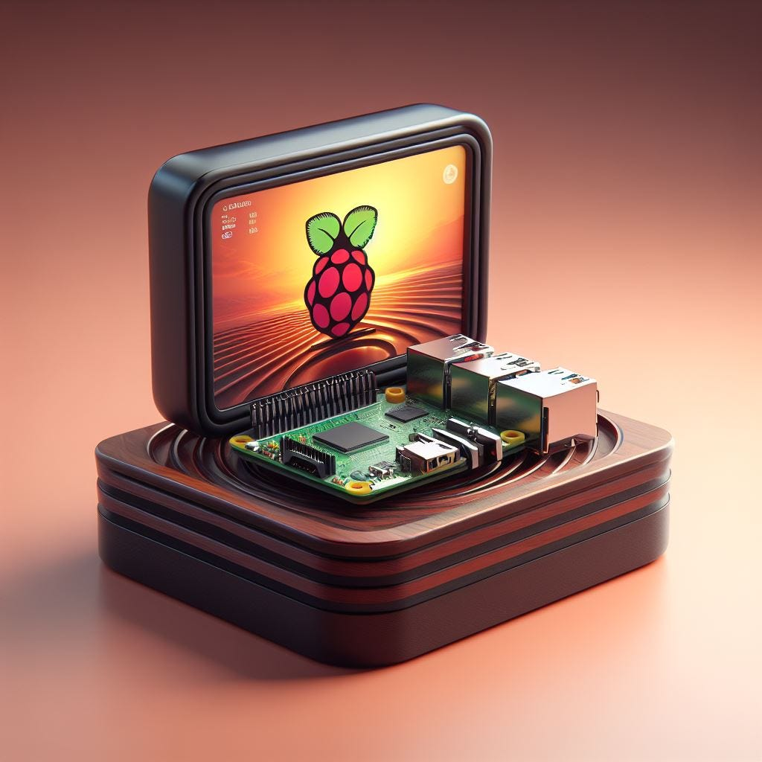

TECHNOLOGY STACK
Frontend
APIs & AI Engine
HTML, CSS, JavaScript: Web interface and user experience
Responsive design for phones & tablets
OpenCV: Real-time image processing
Open Weather Map / Tomorrow.io for temperature, precipitation, UV index
Weather API Integration: Data-driven predictive maintenance
IOT HARDWARE USED
Backend & Database
Node.js, MongoDB: Backend server and data storage , React.js: Mobile app and web dashboard development
TensorFlow, PyTorch: Deep learning and model training
VGG16: CNN based model for working image data
Machine Learning: SVM (Support Vector Classifier)
AWS IoT Core: Cloud device management and data streaming
Raspberry Pi 4B, ESP32: Edge computing and IoT connectivity
Camera Drone for capturing images of solar panels

Slide 11
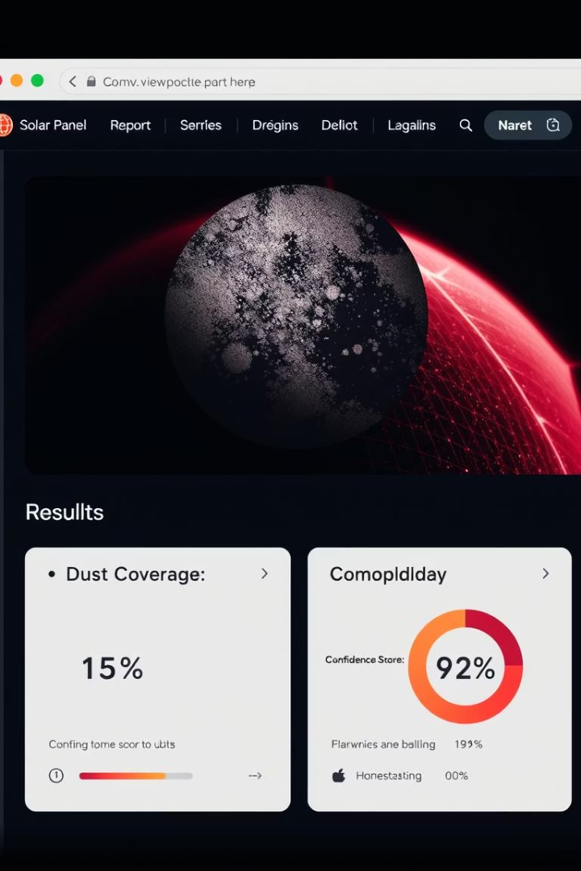
Estimated Implementation Cost:
Proposed System (SOLARENSE): ₹25,000 - ₹40,000 per unit
Existing Robotic Solutions: ₹30+ lakh per unit
Manual Cleaning (Recurring): ₹3–5 lakh/year for large solar farms
Key Advantage:
~70% cheaper than robotic cleaners
Payback period < 2 years through higher energy output & lower O&M costs

Slide 12


